Slide 1
Step 4
DEVELOP SYSTEM MENUS
& NAVIGATION SCHEMES
Step 4 Overview
The Structures of Menus
The Functions of Menus
The Content of Menus
Formatting Menus
Writing Menus
Navigation Using Menus
Web Site Navigation, Links, Elements
Maintaining a Sense of Place
Types of Menus

Slide 2
Step 4
MENUS & NAVIGATION
Structures of Menus
Single Menus
Sequential Linear Menus
Simultaneous Menus
Hierarchical Menus
Connected Menus
Event-Trapping Menus

Slide 3
Step 4
MENUS & NAVIGATION
Functions of Menus
Navigation to a New Menu
Execute an Action or Procedure
Displaying Information
Data or Parameter Input
Content of Menus
Context
Title
Choice Descriptions
Completion Instructions

Slide 4
Step 4
FORMATTING OF MENUS
Consistency
Provide consistency with the user’s expectations
Provide consistency in menus:
    Formatting, including organization, presentation,
    and choice ordering
    Phrasing, including titles, choice descriptions,
    and instructions
    Choice selection methods
    Navigation schemes

Slide 5
Step 4
FORMATTING OF MENUS
Display
If continual or frequent references to menu options are necessary, permanently display
the menu in an area of the screen that will not obscure other screen data
If only occasional references to menu options are necessary, the menu may be presented
on demand
Critical options should be continuously displayed

Slide 6
Step 4
FORMATTING OF MENUS
Presentation
Ensure that a menu and its choices are obvious to the user by presenting them with a unique
and consistent:
  Structure
  Location and/or
  Display technique
Ensure that other system components do not possess the same visual qualities as menu choices

Slide 7
Step 4
FORMATTING OF MENUS
Organization
Provide a general or main menu
Display:
  All relevant alternatives
  Only relevant alternatives
    Delete or gray-out inactive choices
Match the menu structure to the structure of the task
  Organize to reflect the most efficient sequence of steps to accomplish frequent or likely goals
Minimize number of menu levels within limits of clarity
  For Web sites, restrict to two levels (requiring two mouse clicks) for fastest performance

Slide 8
Step 4
FORMATTING OF MENUS
Organization (Continued)‏
Be conservative in the number of menu choices presented on a screen:
  Without logical groupings of elements, limit choices to 4 to 8
  With logical groupings of elements, limit choices to 18 to 24
Provide decreasing direction menus, if sensible
Never require menus to be scrolled

Slide 9
Step 4
FORMATTING OF MENUS
Complexity
Provide both simple and complex menus
  Simple: a minimal set of actions and menus
  Complex: a complete set of actions and menus
Item Arrangement
Align alternatives or choices into single columns whenever possible
  Orient for top-to-bottom reading
  Left-justify descriptions
If a horizontal orientation of descriptions must be maintained, organize for left-to-right reading

Slide 10
Step 4
FORMATTING OF MENUS
Ordering
Order lists of choices by their natural order, or
  For lists associated with numbers, use numeric order
  For textual lists with a small number of options (seven or less), order by:
    Sequence of occurrence
    Frequency of occurrence
    Importance
    Semantic similarity
Use alphabetic order:
  For long lists (eight or more options)‏
  For short lists with no obvious pattern or frequency
  To separate potentially destructive actions from frequently chosen items
Maintain a consistent ordering of options on all related menus
  Variable length menus, maintain relative positions
  Fixed-length menus, maintain absolute positions

Slide 11
Step 4
FORMATTING OF MENUS
Groupings
Create groupings of items that are logical, distinctive, meaningful, and mutually exclusive
Categorize them in such a way as to:
  Maximize the similarity of items within a category
  Minimize the similarity of items across categories
Present no more than 6 or 7 groupings on a screen
Order categorized groupings in a meaningful way
If meaningful categories cannot be developed and more than eight options must be displayed on a screen, create arbitrary visual groupings that:
  Are of about 4 or 5 but never more than 7 options
  Are of equal size
Separate groupings created through either wider spacing, or thin ruled line
Provide immediate access to critical or frequently chosen items

Slide 12
Step 4
FORMATTING OF MENUS
Line Separators
Separate vertically arrayed groupings with subtle
solid lines
Separate vertically arrayed subgroupings with
subtle dotted or dashed lines
For subgroupings within a category:
  Left-align the lines under the first letter of the columnized choice descriptions
  Right-align the lines under the last character of the longest choice description
For independent groupings, extend the line to the left and right menu borders

Slide 13
Step 4
SELECTION SUPPORT MENUS
Changeable or Adaptive Menus
More frequently chosen options are positioned at the menu’s top based upon the menu’s use
Traditional Menu
  Items are always arranged and presented in a pre-established order
Split Menu
  Frequently chosen items are duplicated at the top of the menu
Folded Menu
  Frequently chosen items appear first and alone in their normal menu positions
  The complete menu appears after a time delay

Slide 14
Step 4
SELECTING SUPPORT MENUS
When a small, discrete set of functions is accessed 90% or more of the time, use folded menus
When a small set of items is selected between 31 and 89% of the time and the other items are selected with lower frequencies, use split menus
If there is no small, discrete set of items that is used 30% of the time or more, use traditional menus
Do not dynamically reorder menus

Slide 15
Step 4
PHRASING THE MENU
A menu must communicate information about:
The nature and purpose of the menu itself
The nature and purpose of each presented choice
How the proper choice or choices may be selected

Slide 16
Step 4
PHRASING THE MENU
Menu Titles
Main menu:
  Create a short, simple, clear, and distinctive title, describing the purpose of the entire series of choices
Submenus:
  Submenu titles must be worded exactly the same as the menu choice previously selected to display them
General:
  Locate the title at the top of the listing of choices
  Spell out the title fully using either:
    Uppercase font
    Mixed-case font in the headline style
  Superfluous titles may be omitted

Slide 17
Step 4
PHRASING THE MENU
Menu Choice Descriptions
Create meaningful choice descriptions that are:
  Familiar
  Fully Spelled Out
  Concise
  Distinctive
Descriptions may be single words, compound words, multiple words, or phrases
  Exception: Menu bar items should be a single word (if possible)‏
Place the keyword (usually a verb) first
Use sentence or headline style
Use task-oriented not data-oriented wording
Use parallel construction

Slide 18
Step 4
PHRASING THE MENU
Menu Choice Descriptions (Continued)‏
A menu choice must never have the same wording as
its menu title
Identical choices on different menus should be
worded identically
Choices should not be numbered
  Exception: If the listing is numeric in nature, graphic, or a list
  of varying items, it may be numbered
If menu options will be used in conjunction with a command language, the capitalization and syntax of
the choices should be consistent with the language
Word choices as commands to the computer

Slide 19
Step 4
PHRASING THE MENU
Menu Instructions
For novice or inexperienced users, provide menu completion instructions
  Place the instructions in a position just preceding the part, or parts, of the menu to which they apply
  Present instructions in a mixed-case font in the sentence style
  For expert users, make these instructions easy to ignore by:
    Presenting them in a consistent location
    Displaying them in a unique type style and/or color

Slide 20
Step 4
PHRASING THE MENU
Intent Indicators
Cascade Indicator:
  To indicate that selection of an item will lead to a submenu, place a triangle or right-pointing solid arrow following the choice
  A cascade indicator must designate every cascaded menu
To a Window Indicator:
  For choices that result in displaying a window to collect more information, place an ellipsis (...) immediately following the choice
    Exceptions—do not use when an action:
      Displays a warning window
      May or may not lead to a window
Direct Action Items:
  For choices that directly perform an action, no special indicator should be placed on the menu

Slide 21
Step 4
PHRASING THE MENU
Keyboard Equivalents
To facilitate keyboard selection of a menu choice, each menu item should be assigned a keyboard equivalent mnemonic
The mnemonic should be the first character of the menu item’s description
If duplication exists in first characters, use another character in the duplicated item’s description, preferably the first succeeding consonant
Designate the mnemonic character by underlining it
Use industry-standard keyboard access equivalents when they exist

Slide 22
Step 4
PHRASING THE MENU
Keyboard Accelerators
For frequently used items, provide a keyboard accelerator to facilitate keyboard selection
The accelerator may be one function key or a combination of keys
  Function key shortcuts are easier to learn than modifier plus letter shortcuts
Pressing no more than two keys simultaneously is preferred
  Do not exceed three simultaneous keystrokes
Use a plus (+) sign to indicate that two or more keys must be pressed at the same time
Accelerators should have some associative value to the item
Identify the keys by their actual key top engraving

Slide 23
Step 4
PHRASING THE MENU
Keyboard Accelerators (Continued)‏
If keyboard terminology differences exist, use:
  The most common keyboard terminology
  Terminology contained on the newest PCs
Separate the accelerator from the item description
by three spaces
Right-align the key descriptions
Do not use accelerators for:
  Menu items that have cascaded menus
  Pop-up menus
Use industry-standard keyboard accelerators when
they exist

Slide 24
Step 4
SELECTING MENU CHOICES
Initial Cursor Positioning
If one option has a significantly higher probability of selection, position the cursor at that option
If repeating the previously selected option has the highest probability of occurrence, position the cursor at that option
If no option has a significantly higher probability of selection, position the cursor at the first option

Slide 25
Step 4
SELECTING MENU CHOICES
Choice Selection
Pointers:
  Select the choice by directly pointing at it with a mechanical device or with one’s finger
  Visually indicate:
    Which options can be selected
    When the option is under the pointer and selectable
  Visually distinguish single- and multiple-choices
  If pointing with a mechanical device is used:
    The selectable target area should be at least twice the size of the active area of the pointing device, but not less than 6 mm square
    Adequate separation must be provided between adjacent target areas
  If finger pointing is the selection method used:
    Touch area must be 20 to 30 mm square
    The touch area must encompass the entire caption plus one character around it

Slide 26
Step 4
SELECTING MENU CHOICES
Choice Selection (Continued)‏
Keyboard:
  If moving the cursor to a menu choice:
    The up and down arrow keys should move the cursor up or down vertically oriented menu options
    The left and right cursor keys should move the cursor left or right between horizontally oriented menu options
  If keying a choice identifier value within an entry field:
    Locate the entry field at the bottom of the last choice in the array
    of choices
    Uppercase, lowercase, and mixed-case typed entries should be acceptable

Slide 27
Step 4
SELECTING MENU CHOICES
Choice Selection (Continued)‏
Selection/Execution:
  Provide separate actions for selecting and executing menu options
  Indicate the selected choicethrough either:
    Highlighting it with a distinctive display technique
    Modifying the shape of the cursor
  Permit unselecting the choice before execution
    If a menu is multiple choice, permit all options to be selected before execution
Combining Techniques:
  Permit alternative selection techniques, to provide flexibility

Slide 28
Step 4
SELECTING MENU CHOICES
Defaults
Provide a default whenever possible
Display as bold text
Unavailable Choices
Unavailable choices should be dimmed or “grayed out”
Do not add or remove items from a menu unless the user takes explicit action to so through the application

Slide 29
Step 4
SELECTING MENU CHOICES
Mark Toggles or Settings
Purpose:
  Use to designate that an item or feature is active or inactive over a relatively long period of time
  Use to provide a reminder that an item or feature is active or inactive
Guidelines:
  Position the indicator directly to the left of the option
  For situations where several nonexclusive choices may be selected:
    Consider including one alternative that deselects all the items and reverts the state to the “normal” condition

Slide 30
Step 4
SELECTING MENU CHOICES
Toggled Menu Items
Purpose:
  Use to designate two opposite commands that are accessed frequently
  Use when the menu item displayed will clearly indicate that the opposite condition currently exists
Guidelines:
  Provide a meaningful, fully spelled-out description of the action
  Begin with a verb that unambiguously represents the outcome of the command
  Use mixed-case letters, with the first letter of each word capitalized

Slide 31
Step 4
WEB SITE NAVIGATION
Navigation
The method people use to find what they want
Efficient navigation is an important element in usability
Wayfinding
Orientation
  One's current location relative to objects and the destination
Route decision
  The path chosen to get to the destination
Route monitoring
  Monitoring of the path to confirm it is leading to the destination
Destination recognition
  The destination must be recognized when encountered

Slide 32
Step 4
WEB SITE NAVIGATION
Navigation Problems
Technical Issues
  Open-ended with many paths
  Multiple different systems encountered
  Rapid system evolvement and expansion
Usage Issues
  Heavy mental overhead
  Feelings of spatial disorientation
Navigation Goals
Must be obvious:
  Where am I now?
  Where did I come from?
  Where can I go from here?
  How can I get there quickly?

Slide 33
Step 4
WEB SITE NAVIGATION
Menu Navigation Aids
To aid navigation and learning:
  Provide a map or overview of the menu hierarchy
  Provide “clickability” cues
  A “look ahead” at the next level of choices, alternatives that will be presented when a currently viewed choice is selected
Provide feedback concerning one's current location
  Navigation history
  Link text (or label) matched to the destination page heading

Slide 34
Step 4
WEB SITE NAVIGATION
Web Site Organization
Divide content into logical fragments, units, or chunks
Establish a hierarchy of generality or importance
Structure the relationships among content fragments, units, or chunks
  Establish global or site-wide navigation requirements
Create a well-balanced hierarchical tree
  Restrict to two levels requiring no more than two clicks to reach deepest content, whenever possible

Slide 35
Step 4
WEB SITE NAVIGATION
Navigation Page Design
Use appropriate menu types
  Sequential menus for simple forward-moving tasks
  Simultaneous menus for tasks that would otherwise require extensive Back button use
Keep navigation-only pages short
Limit prose text
Scrolling
  Never require scrolling of navigation-only pages
  Minimize the need for scrolling to view all links on pages containing content
  Never require horizontal scrolling

Slide 36
Step 4
COMPONENTS OF A WEB NAVIGATION SYSTEM
All navigation controls must:
  Make sense in the absence of site context
  Be continually available
  Be obvious and distinctive
  Be consistent in appearance, function, and ordering
  Possess a textual label or description
  Offer multiple navigation paths

Slide 37
Step 4
WEB NAVIGATION ELEMENTS
Differentiate and group navigation elements
  Provide a global navigation bar at the top of each page
  Provide a local category or topical links navigation bar on the left side of a page
    For long lists consider placing within a frame
  Optionally, provide a secondary navigation column on the right side of the page
  Place explicit or embedded textual within the contents area
    Consider duplicating embedded links in the left side navigation bar
  Place minor illustrative, parenthetical, or footnote links at the end of the page
  For long pages provide:
    “List of Content” links
    A navigation bar repeating important global or local links at the page bottom
Create a common and consistent theme
Never create pages without navigational options

Slide 38
Step 4
OTHER NAVIGATION ELEMENTS
Overview
Provide:
  Executive Summary
    Providing a preview of the site and contains links to all major concepts
  Site Map
    Illustrating the site’s hierarchical structure and the relationships of components
  Global and Local Maps
  Alphabetized Site Index
  Table of Contents
Allow accessibility from any point in the Web site

Slide 39
Step 4
OTHER NAVIGATION ELEMENTS
Historical Trails
Provide:
  Breadcrumb Trails
    Locate at the top of the page below the navigation links
  History Lists
  History Trees
  Footprints
  Bookmarks
Search Facility
Provide a search facility

Slide 40
Step 4
LINKS and ACTIONS
Kinds of Links
Internal
Anchor
External
Textual Phrase Links
Provide a mixture of textual phrase links
  In explicit menus
  Embedded within page text

Slide 41
Step 4
LINKS and ACTIONS
Presenting Links
Provide consistent clickability cues
  Avoid misleading cues to click
Use Textual links
  Underline all link text, including that:
    Embedded in page content
    Contained in explicit menu listings
    Contained in headings
    Used as graphical labels
  Exceptions:
    Links in navigation-only menus and in lists do not necessarily need underlining
  Do not underline any text that is not a link
  Distinguish between unselected/unvisited links and selected/visited links
    Make unselected/unvisited links blue
    Make selected/visited links purple
    Never show other text in these colors

Slide 42
Step 4
LINKS and ACTIONS
Presenting Links (Continued)
Distinguish internal, external, anchor links
  Identify external links by:
    Including destination URL address below
    Including “exit disclaimer” adjacent
    Providing an interim page after clicking external
  Identify anchor link with Page Contents heading
Graphical links:
  Clearly identify clickable regions of images
  Distinguish graphical links from decorative graphics by
  underlining text labels

Slide 43
Step 4
LINKS and ACTIONS
Presenting Links (Continued)
Graphical Links:
  Distinguish graphical links from decorative graphics through:
  Underlining graphical text labels
Links in Toolbars:
  Distinguish links in toolbars through:
    Presenting in consistent locations
    Using different colored backgrounds
Fat Links:
  Consider, if appropriate

Slide 44
Step 4
LINKS and ACTIONS
Types of Links
Internal Links Within a Page:
  For long pages, include anchor links to internal page content
Internal Links Within a Web Site:
  On all pages include links to:
    The Web site home page
    Global Web site features
    Other main pages, navigation points, or categories
    The likely Web site starting point
    Main pages with links to the page
On sequential pages, include links to the:
  Next page
  Previous page

Slide 45
Step 4
LINKS and ACTIONS
Types of Links (Continued)‏
Also consider including links to:
  Places of related interest
  Important pages
  Background or explanatory information
  Supplemental information
  New or changed content
  Web site Quit or Exit
External Links:
  Most appropriate for informational sites
  Provide links to relevant information on other sites
    Related content
    Reference information
    Background reading
  Place external links on a separate page
  Provide an indication when a link goes outside the current site

Slide 46
Step 4
LINKS and ACTIONS
Writing Link Labels
Create meaningful labels:
  Containing action words
  Positioning keywords at the beginning
  Long enough to be understood
  Clearly indicating destination or action
  Matching link name with destination page
Ensure that embedded links are descriptive
Provide glosses or link labels to aid understanding
Number of Links
Every page should contain at least one link
Be conservative in total number of links presented
  Restrict embedded links to most important, pertinent, interesting
  Place less relevant links in a listing

Slide 47
Step 4
LINKS and ACTIONS
Other Link Guidelines
Grouping:
  Group links by the most relevant menu-grouping scheme
  Separate visually the following types of navigation:
    Upward to the immediate parent page
    Upward to the beginning of the section or category of information
    Across to main sections or categories of information
    To basic utilities
Ordering
  Order links by the most relevant menu choice-ordering scheme
Multi-level pages
  Provide one simple action to:
    Return to next higher-level page
    Return to the homepage

Slide 48
Step 4
LINKS and ACTIONS
Other Link Guidelines (Continued)‏
Heading:
  Where appropriate, provide a listing heading describing the organizing category, principle, or theme
Size:
  Provide graphical images and command buttons of sufficient and equal size
Spacing:
  Create equal spacing between choices graphical image and textual listing toolbars
Inapplicability:
  Disable and display dimmed links conditionally not applicable

Slide 49
Step 4
Links and Actions
Link Maintenance
Maintain correct internal links
Frequently check and correct external links

Slide 50
Step 4
MAINTAINING A SENSE OF PLACE
Design Characteristics That Aid in Maintaining a Sense of Place
To assist maintaining a sense of place within a Web site:
  Provide a simple hierarchical tree structure
  Provide ease of movement to important site features
To assist maintaining a sense of place across multiple Web sites:
  Provide consistency in all Web site design elements, including:
    Graphical identity schemes
    Component presentation
    Component organization and location

Slide 51
Step 4
MAINTAINING A SENSE OF PLACE
Design Elements That Aid in Maintaining a Sense of Place
Provide a home base
Use recurring navigation tools on all pages
Use recurring elements on all pages
Provide page numbers for sequential pages
Provide ongoing feedback that shows where users are in a site
Provide on-demand aids that illustrate the user’s location within a site
  Site maps
  Table of contents
Provide clearly written link labels

Slide 52
Step 4
KINDS OF GRAPHICAL MENUS
Considerations in Choosing a Menu
The number of items to be presented in the menu
How often the menu is used
How often the menu contents may change
Overview of Menu Kinds
Menu Bar
Pull-Down Menu
Cascading Menus
Pop-Up Menus
Tear-Off Menus
Iconic Menus
Pie Menus

Slide 53
Step 4
MENU BARS
Proper Usage
To identify and provide access to:
  Common and frequently used application actions
  Actions that take place in a wide variety of different windows
A menu bar choice by itself should not initiate an action
Design Guideline Overview
Advantages & Disadvantages
Item Descriptions
Organization

Slide 54
Step 4
PULL-DOWN MENUS
Proper Usage
To initiate frequently used application actions that take place on a wide variety of different windows
For a small number of items
For items best represented textually
For items whose content rarely changes
Design Guideline Overview
Advantages & Disadvantages
Display
Size
Organization
Groupings

Slide 55
Step 4
CASCADING MENUS
Proper Usage
To reduce the number of choices presented together for selection (reduce menu breadth)‏
When a menu specifies many alternatives and the alternatives can be grouped in meaningful related sets on a lower-level menu
When a choice leads to a short, fixed list of single-choice properties
When there are several fixed sets of related options
To simplify a menu
Avoid using for frequent, repetitive commands
Design Guideline Overview
Advantages & Disadvantages
Cascade Indicator
Levels

Slide 56
Step 4
POP-UP MENUS
Proper Usage
To present alternatives or choices within the context of the task
Design Guideline Overview
Advantages & Disadvantages
Display
Location
Size

Slide 57
Step 4
TEAR-OFF MENUS
Proper Usage
A pull-down menu can be positioned anywhere on the screen for continuing referral
For Items:
  Sometimes frequently selected
  Sometimes infrequently selected
  Small in number (5-10)
  Rarely changing in content
Design Guideline Overview
Follow all relevant guidelines for pull-down menus

Slide 58
Step 4
ICONIC MENUS
Proper Usage
To remind users of the functions, commands, attributes, or application choices available
Design Guideline Overview
Create icons that:
  Help enhance recognition and hasten option selection
  Are concrete and meaningful
  Clearly represent choices

Slide 59
Step 4
PIE MENUS
Proper Usage
Consider using for:
  Mouse-driven selections, with one- or two-level hierarchies
  Short lists
  Choices conducive to format

Slide 60
Step 5
SELECT THE PROPER KINDS
OF WINDOWS
Step 5 Overview
A window’s characteristics
A window’s components
A window’s presentation styles
The types of windows available
Organizing window system functions
A window’s operations
Web frames and pop-up windows

Slide 61
Step 5
WINDOW CHARACTERISTICS
A name or title, allowing it to be identified
A size in height and width
A state, accessible or active, or not accessible
Visibility—the portion that can be seen
A location, relative to the display boundary
Presentation, that is, its arrangement in relation to other windows
Management capabilities
Its highlight, that is, the part that is selected
The function, task, or application to which it is dedicated

Slide 62
Step 5
WINDOW CHARACTERISTICS
The Attraction of Windows
Presentation of different levels of information
Presentation of multiple kinds of information
Sequential presentation of levels or kinds of information
Access to different sources of information
Combining multiple sources of information
Performing More than one task
Reminding
Monitoring
Multiple representations of the same task

Slide 63
Step 5
WINDOW CHARACTERISTICS
Constraints in Window System Design
Historical Considerations
Hardware Limitations
Human Limitations
Other Limitations
Where To?

Slide 64
Step 5
COMPONENTS OF A WINDOW
Frame
Title Bar
Title Bar Icon
Window Sizing Buttons
What’s This? Button
Menu Bar
Status Bar
Scroll Bars
Split Box
Toolbar
Command Area
Size Grip
Work Area

Slide 65
Step 5
WINDOW PRESENTATION STYLES
Use tiled windows for:
  Single-task activities
  Data that needs to be seen simultaneously
  Tasks requiring little window manipulation
  Novice or inexperienced users
Use overlapping windows for:
  Switching between tasks
  Tasks necessitating a greater amount of window manipulation
  Expert or experienced users
  Unpredictable display contents
Cascading windows

Slide 66
Step 5
TYPES OF WINDOWS
Primary Window
Proper Usage:
  Represent an independent function or application
  Present constantly used window components and controls
    Menu bar items that are:
      Used frequently
      Used by most, or all, primary or secondary windows
    Controls used by dependent windows
      Presenting information that is continually updated
      Providing context for dependent windows
  Do not:
    Divide an independent function into two or more primary windows
    Present unrelated functions in one primary window

Slide 67
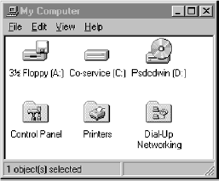

Slide 68
Step 5
TYPES OF WINDOWS
Secondary Windows
Proper Usage:
  Performing subordinate, supplemental, or ancillary actions
  that are:
    Extended or more complex in nature
    Related to objects in the primary window
  Presenting frequently or occasionally used window components
Important Guidelines:
  Should typically not appear as an entry on the taskbar
  A secondary window should not be larger than 263 x 263
  dialog units

Slide 69
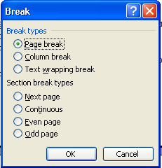

Slide 70
Step 5
TYPES OF WINDOWS
Modal Secondary Windows
Use when interaction with any other window must not
be permitted. Use for:
  Presenting information
    For example, messages (sometimes called a message box)‏
  Receiving user input
    For example, data or information (sometimes called a prompt box)‏
  Asking questions
    For example, data, information, or directions (sometimes called a
    question box)‏
  Use carefully because it constrains what the user can do
Modeless Secondary Windows
Use when interaction with other windows:
  Must be permitted
  Must be repeated

Slide 71
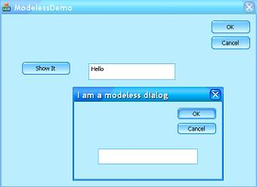

Slide 72
Step 5
TYPES OF WINDOWS
Cascading Secondary Windows
Purpose:
  To provide advanced options at a lower level in a complex dialog
Guidelines:
  Provide a command button leading to the next dialog box with a “To a Window” indicator
    An ellipsis (...)‏
  Present the additional dialog box in cascaded form
  Provide no more than two cascades in a path
  Do not cover previous critical information
    Title Bar
    Relevant displayed information
  If independent, close the secondary window from which it was opened

Slide 73
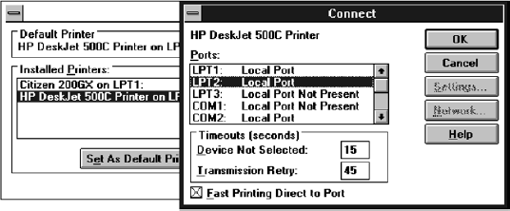
Window

Slide 74
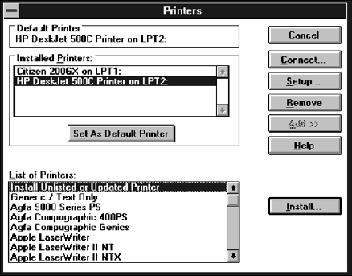
Step 5
TYPES OF WINDOWS
Unfolding Secondary Windows
Purpose:
  To provide advanced options at the same level in a complex dialog
Guidelines:
  Provide a command button with an expanding dialog symbol (>>)‏
  Expand to right or downward

Slide 75
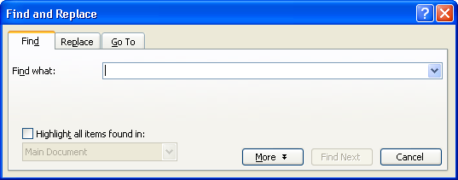
Step 5
TYPES OF WINDOWS
Dialog Boxes
Purpose:
  For presenting brief messages
  For requesting specific, transient actions
  For performing actions that:
    Take a short time to complete
    Are not frequently changed
Guidelines:
  Command buttons to include:
    OK
    Cancel
    Others as necessary

Slide 76
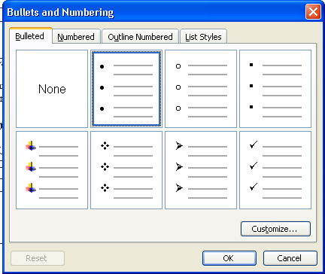
Step 5
TYPES OF WINDOWS
Property Sheets
Purpose:
  Use for presenting the complete set of properties for an object
Guidelines:
  Categorize and group within property pages
    Use tabbed property pages for grouping peer-related property sets
  Command buttons to include:
    OK
    Cancel
    Apply
    Reset
    Others as necessary
  For single property sheets:
    Place commands on the sheet
  For tabbed property pages:
    Place commands outside the tabbed pages

Slide 77

Step 5
TYPES OF WINDOWS
Property Inspectors
Purpose:
  Use for displaying only the most common or frequently accessed object properties
Guideline:
  Make changes dynamically

Slide 78
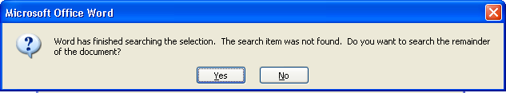
Step 5
TYPES OF WINDOWS
Message Boxes
Purpose:
  Use for displaying a message about a particular situation or condition
Guidelines:
  Command buttons to include:
    OK
    Cancel
    Help
    Yes and No
    Stop
    Buttons to correct the action that caused the message box to be displayed
  Enable the title bar close box only if the message includes a cancel button
  Designate the most frequent or least destructive option as the default command button

Slide 79

Step 5
TYPES OF WINDOWS
Palette Windows
Purpose:
  Use to present a set of controls
Guidelines:
  Design as resizable
    Alternatively, design as fixed in size

Slide 80
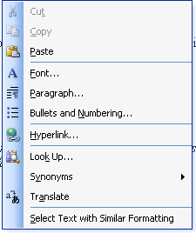
Step 5
TYPES OF WINDOWS
Pop-up Windows
Use pop-up windows to display:
  Additional information when an abbreviated form is the main presentation
  Collect secondary information
  Textual labels for graphical controls
  Context-sensitive Help information
Guidelines:
  Present at front of screen
  One-quarter to one-third window size
  OK, Cancel, and Save buttons
  Never display unsolicited pop-up

Slide 81
Step 5
ORGANIZING WINDOW FUNCTIONS
Window Organization
Organize windows to support user tasks
Support the most common tasks in the most efficient sequence of steps
Use primary windows to:
  Begin an interaction and provide a top-level context for dependent windows
  Perform a major interaction
Use secondary windows to:
  Extend the interaction
  Obtain or display supplemental information related to the primary window
Use dialog boxes for:
  Infrequently used or needed information
  “Nice-to-know” information

Slide 82
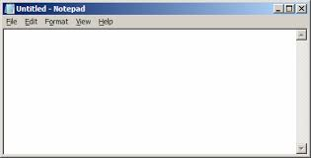
Window Management
Single-Document Interface

Slide 83
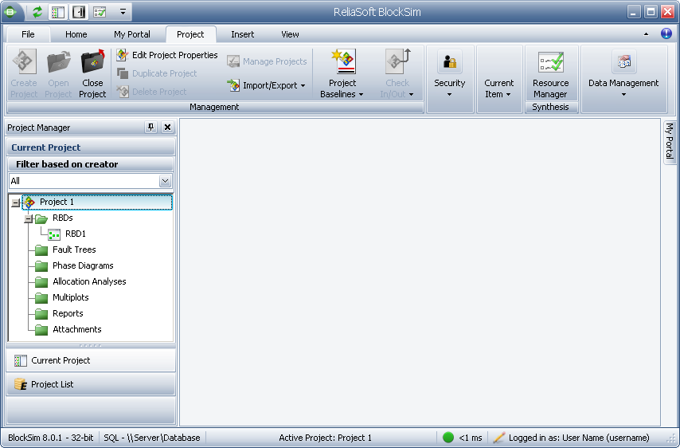
Multiple-Document Interface

Slide 84
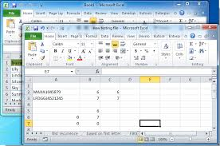
Workbooks

Slide 85
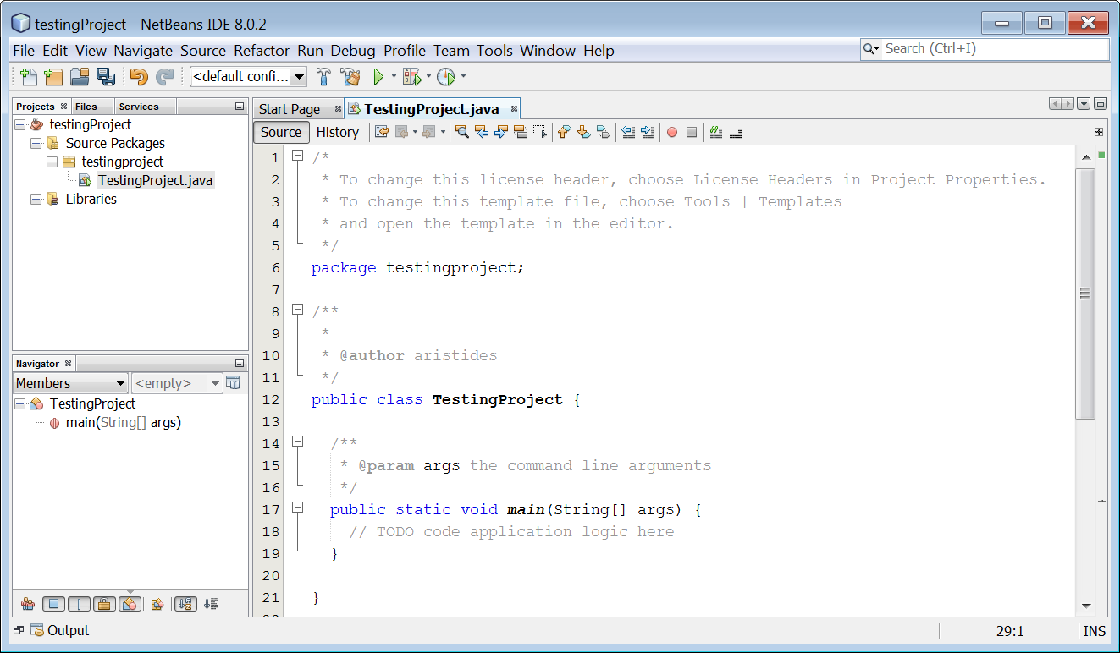
Projects

Slide 86
Step 5
ORGANIZING WINDOW FUNCTIONS
Poor functional organization is often a result of:
  Emphasis on technical ease of implementation rather than proper analysis of user tasks
  Focus on applications, features, functions, or data types instead of tasks
  Organization of the design team into applications, with little cross-team communication
  Blindly mimicking the manual world and carrying over manual inefficiencies to the computer system
Number of Windows
  Minimize the number of windows needed to accomplish an objective

Slide 87
Step 5
WINDOW OPERATIONS
Sizing Windows
Provide large-enough windows to:
  Present all relevant and expected information for the task
  Avoid hiding important information
  Avoid crowding or visual confusion
  Minimize the need for scrolling
    But use less than the full size of the screen
If a window is too large, determine:
  Is all the information needed?
  Is all the information related?
Otherwise, make the window as small as possible
  Optimum window sizes:
    For text, about 12 lines
    For alphanumeric information, about 7 lines

Slide 88
Step 5
WINDOW OPERATIONS
Advantages of larger windows
  Permit displaying of more information
  Facilitate learning: Data relationships and groupings are more obvious
  Less window manipulation requirements exist
  Breadth is preferred to depth (based on menu research)‏
  More efficient data validation and data correction can be performed
Disadvantages of larger windows
  Longer pointer movements are required
  Windows are more crowded
  More visual scanning is required
  Other windows more easily obscure parts of the window
  Not as easy to hide inappropriate data

Slide 89
Step 5
WINDOW OPERATIONS
Window Placement
Considerations:
  In placing a window on the display, consider:
    The use of the window
    The overall display dimensions
    The reason for the window’s appearance
General:
  Position the window so it is entirely visible
  If the window is being restored, place the window where it last appeared
  If the window is new, and a location has not yet been established, place it:
    At the point of the viewer’s attention, usually the location of the pointer or cursor
    In a position convenient to navigate to
    So that it is not obscuring important or related underlying window information

Slide 90
Step 5
WINDOW OPERATIONS
Window Placement (Continued)‏
For multiple windows, give each additional window its own unique and discernible location
  A cascading presentation is recommended
In a multiple-monitor configuration, display the secondary window on the same monitor as its primary window
If none of the above location considerations apply, then:
  Horizontally center a secondary window within its primary window just below the title bar, menu bar, and any docked toolbars
If the user then moves the window, display it at this new location the next time the user opens the window
  Adjust it as necessary to the current display configuration
Do not let the user move a window to a position where it cannot be easily repositioned

Slide 91
Step 5
WINDOW OPERATIONS
Window Placement (Continued)‏
Dialog boxes:
  If the dialog box relates to the entire system, center it on screen
  Keep key information on the underlying screen visible
  If one dialog box calls another, make the new one movable whenever possible

Slide 92
Step 5
WEB SYSTEMS‏
Browser Components
    Back
    Forward
    Stop
    Refresh
    Home
    Search
    Favorites
    History

Slide 93
Step 5
WEB SYSTEMS
Frames
Description:
  Multiple Web screen panes that permit the displaying of multiple documents on a page
  These documents can be independently viewed, scrolled, and updated
  The documents are presented in a tiled format
Proper usage:
  For content expected to change frequently
  To allow users to change partial screen content
  To permit users to compare pieces of information
Guidelines:
  Use only a few frames (three or less) at a time
  Choose sizes based upon the type of information to be presented
  Never force viewers to resize frames to see information
  Never use more than one scrolling region on a page

Slide 94
Step 5
WEB SYSTEMS
Pop-Up Windows
Be extremely cautious in the use of pop-up windows

Slide 95
Step 6
SELECT THE PROPER
INTERACTION DEVICES
Step 6 Overview
Input Devices
  Trackball
  Joystick
    Graphic tablet
  Light pen
  Touch screen
  Voice
  Mouse
  Keyboard
  Selecting Devices
  Pointers
Output Devices
  Screens
  Speakers

Slide 96
Step 6
CHARACTERISTICS OF
INPUT DEVICES
Tasks:
Point at an object on the screen
Select the object or identify it as the focus of attention
Drag an object across the screen
Draw something free form on the screen
Track or follow a moving object
Orient or position an object
Enter or manipulate data or information

Slide 97
Step 6
CHARACTERISTICS OF
INPUT DEVICES
Types:
Direct
  Operated on screen itself
Indirect
  Operated in location other than on screen
Discrete
  Enter individual bits of information
Continuous
  Operate sequentially

Slide 98
Step 6
CHARACTERISTICS OF
INPUT DEVICES
Device-pointer relationship
Direction
Distance
Speed

Slide 99

Step 6
TRACKBALL
Description:
  A spherical object (ball) that rotates freely in all directions in its socket
  Direction and speed is tracked and translated into cursor movement
Advantages:
  Direct relationship between hand and pointer movement in terms of direction and speed
  Does not obscure vision of screen
  Does not require additional desk space (if mounted on KB)‏
Disadvantages:
  Movement is indirect, in a plane different from the screen
  No direct relationship exists between hand and pointer movement in terms of distance
  Requires a degree of eye-hand coordination
  Requires hand to be removed from keyboard keys
  Requires different hand movements
  Requires additional desk space (if not mounted on keyboard)‏
  May be difficult to control
  May be fatiguing to use over extended time

Slide 100

Step 6
JOYSTICK
Description:
A stick or bat-shaped device anchored at the bottom
Variable in size, smaller ones being operated by fingers, larger ones requiring the whole hand
Variable in cursor direction movement method, force joysticks respond to pressure, movable to movement
Variable in degree of movement allowed, from horizontal-vertical only to continuous
Advantages:
Direct relationship between hand and pointer movement in terms of direction
Does not obscure vision of screen
Does not require additional desk space (if mounted on KB)‏
Disadvantages:
Movement indirect, in plane different from screen
Indirect relationship between hand and pointer in terms of speed and distance
Requires a degree of eye-hand coordination
Requires hand to be removed from keyboard keys
Requires different hand movements to use
Requires hand to be removed from keyboard (if not on KB)
Requires additional desk space (if not on KB)‏
May be fatiguing to use over extended time
May be slow and inaccurate

Slide 101

Step 6
GRAPHIC TABLET TRACKPAD
Description:
Pressure-, heat-, light-, or light-blockage-sensitive horizontal surfaces that lie on the desktop or keyboard
May be operated with fingers, light pen, or objects like a stylus or pencil
Pointer imitates movements on tablet
Advantages:
Direct relationship between touch movements and pointer movements in terms of direction, distance, and speed
More comfortable horizontal operating plane
Does not obscure vision of screen
Disadvantages:
Movement is indirect, in a plane different from screen
Requires hand to be removed from keyboard
Requires hand to be removed from keyboard keys
Requires different hand movements to use
Requires additional desk space
Finger may be too large for accuracy with small objects

Slide 102

Step 6
TOUCH SCREEN
Description:
A special surface on the screen sensitive to finger or stylus
Advantages:
Direct relationship between hand and pointer location in terms of direction, distance, and speed
Movement is direct, in the same plane as screen
Requires no additional desk space
Stands up well in high-use environments
Disadvantages:
Finger may obscure part of screen
Finger may be too large for accuracy with small objects
Requires moving the hand far from the keyboard to use
Very fatiguing to use for extended period of time
May soil or damage the screen
Design Guidelines:
Screen objects should be at least 3/4" x 3/4" in size
Object separation should be at least 1/8"
Provide visual feedback in response to activation
  Auditory feedback may also be appropriate
When the consequences are destructive, require confirmation to eliminate inadvertent selection
Provide an instructional invitation to begin using

Slide 103

Step 6
LIGHT PEN
Description:
A special surface on a screen sensitive to the touch of a special stylus
or pen
Advantages:
Direct relationship between hand and pointer movement in terms of direction, distance, and speed
Movement is direct, in the same plane as screen
Requires minimal additional desk space
Stands up well in high-use environments
More accurate than finger touching
Disadvantages:
Hand may obscure part of screen
Requires picking it up to use
Requires moving the hand far from the keyboard to use
Very fatiguing to use for extended period of time

Slide 104
Step 6
VOICE
Description:
Automatic speech recognition by the computer
Advantages:
Simple and direct
Useful for people who cannot use a keyboard
Useful when the user’s hands are occupied
Disadvantages:
High error rates due to difficulties in:
  Recognizing boundaries between spoken words
  Blurred word boundaries due to normal speech patterns
Slower throughput than with typing
Difficult to use in noisy environments
Impractical to use in quiet environments

Slide 105

Step 6
MOUSE
Description:
A rectangular or dome-shaped, movable, desktop control containing from one to three buttons
Movement of screen pointer mimics the mouse movement
Advantages:
Direct relationship between hand and pointer movement in terms of direction, distance, and speed
Permits a comfortable hand resting position
Selection mechanisms are included on mouse
Does not obscure vision of the screen
Disadvantages:
Movement is indirect, in a plane different from screen
Requires hand to be removed from keyboard
Requires additional desk space
May require long movement distances
Requires a degree of eye-hand coordination
Mouse Usage Guidelines:
Provide a “hot zone” around small or thin objects
Never use double-clicks or double-drags as the only means of carrying out essential operations
Do not use mouse plus keystroke combinations
Do not require a person to point at moving target

Slide 106
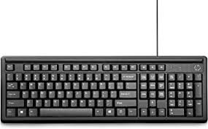
Step 6
KEYBOARD
Description:
Standard typewriter keyboard and cursor movement keys
Advantages:
Familiar
Accurate
Does not take up additional desk space
Very useful for:
  Entering text and alphanumeric data
  Inserting in text and alphanumeric data
  Keyed shortcuts—accelerators
  Keyboard mnemonics—equivalents
Advantageous for:
  Performing actions when less than three mouse buttons
  Use with very large screens
  Touch typists
Disadvantages:
Slow for non-touch-typists
Slower than other devices in pointing
Requires discrete actions to operate
No direct relationship between finger or hand movement on the keys and cursor movement on screen in terms of speed and distance

Slide 107
Step 6
KEYBOARD GUIDELINES
Provide keyboard accelerators
  Assign single keys for frequently performed, small-scale tasks
  Use standard platform accelerators
  Assign Shift+key combinations for actions that extend or are complementary to the actions of the key or key combination used without the Shift key
  Assign Ctrl+key combinations for infrequent actions
  Tasks that represent larger-scale versions of the task assigned to the unmodified key
Provide keyboard equivalents
  Use standard platform equivalents
  Use the first letter of the item description
  If first letter conflicts exist, use:
    Another distinctive consonant in the item description
    A vowel in the item description
Provide window navigation through use of KB keys

Slide 108
Step 6
OTHER INPUT DEVICES
    Gesture
    Eye Tracking
    Iris Recognition
    Fingerprint Recognition
    Handwriting

Slide 109
Step 6
SELECTING THE PROPER CONROLS
Keyboard Versus Mouse
Mouse Pointing Speed: 1.5 to 2 seconds
Typing Speeds in 1.5 to 2 seconds:
  Skilled typist - 13 to 15 characters
  Average typist - 4 to 6 characters
Control Research Example
Pointing and Dragging:
  Pointing at stationary targets
    Direct devices
  Positioning speed and accuracy for stationary targets
    Indirect devices do not differ greatly
  Separate confirmation action following pointer positioning
    Increases pointing accuracy but reduces speed
  Tracking small, slowly moving targets
    Mouse, trackball, and graphic tablet preferred

Slide 110
Step 6
GUIDELINES FOR SELECTING THE PROPER CONROLS
Consider the characteristics of the task
  Provide keyboards for tasks involving:
    Heavy text entry and manipulation
    Movement through structured array of objects
  Provide an alternative pointing device for graphical or drawing tasks
  Provide touch screens under the following conditions:
    The opportunity for training is minimal
    Targets are large, discrete, and spread out
    Frequency of use is low
    Desk space is at a premium
    Little or no text input requirement exists
Consider user characteristics and preferences
  Provide keyboards for touch typists
Consider the characteristics of the environment
Consider the characteristics of the hardware
Consider the characteristics of the application
Provide flexibility
Minimize device eye and hand movements

Slide 111
Step 6
POINTER GUIDELINES
The pointer:
  Should be visible at all times
  Should contrast well with its background
  Should maintain its size across all locations and movement
  The hotspot should be easy to locate and see
  Location should not warp (change position)‏
The user should always position the pointer
The shape of a pointer:
  Should clearly indicate its purpose and meaning
  Should be constructed of already defined shapes
  Should not be used for any other purpose other than its already defined meaning
  Do not create new shapes for defined standard functions
Use only as many shapes as necessary to inform the user about current location and status. Too many confuse
Be conservative in making changes as the pointer moves across the screen
  Provide a short “time-out” before making non-critical changes on the screen
Animation should not:
  Distract
  Restrict one’s ability to interact

Slide 112
Step 6
OUTPUT DEVICES
    Screens
    Speakers

